Slide 1
Rotation 3 Figures / Tables
Timir Weston

Slide 2
2000 – Statistical Comparison
miRNA | P value (significant for CVD event)
 | No Correction | Corrected for Age, Sex | Corrected for Age, Sex, Lipids
miR-122 | 0.050 | 0.724 | 0.251
miR-126 | 0.298 | 0.704 | 0.749
miR-146a | 0.823 | 0.752 | 0.701
miR-148a | 0.470 | 0.341 | 0.404
miR-150 | 0.065 | 0.709 | 0.386
miR-155 | 0.726 | 0.513 | 0.528
miR-191 | 0.199 | 0.752 | 0.861
miR-195 | 0.590 | 0.955 | 0.946
miR-197 | 0.970 | 0.734 | 0.608
miR-21 | 0.459 | 0.515 | 0.404
miR-223 | 0.276 | 0.828 | 0.905
miR-24 | 0.763 | 0.872 | 0.746
miR-27b | 0.540 | 0.352 | 0.316
miR-28-3p | 0.884 | 0.680 | 0.551
miR-320 | 0.121 | 0.115 | 0.087
miR-335 | 0.325 | 0.343 | 0.268
miR-378 | 0.786 | 0.535 | 0.654
miR-92a | 0.395 | 0.267 | 0.226

Slide 3
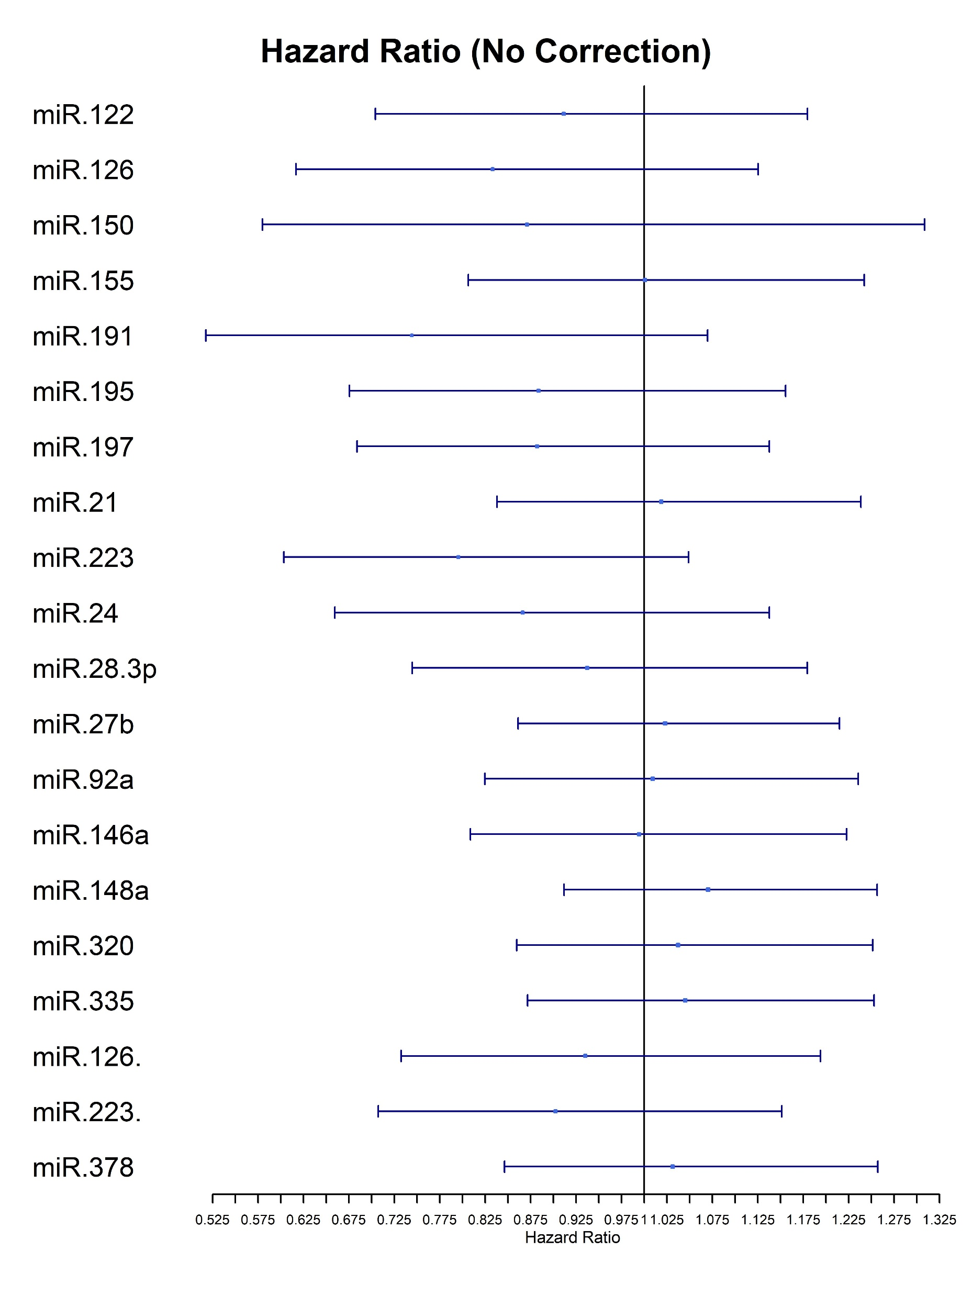
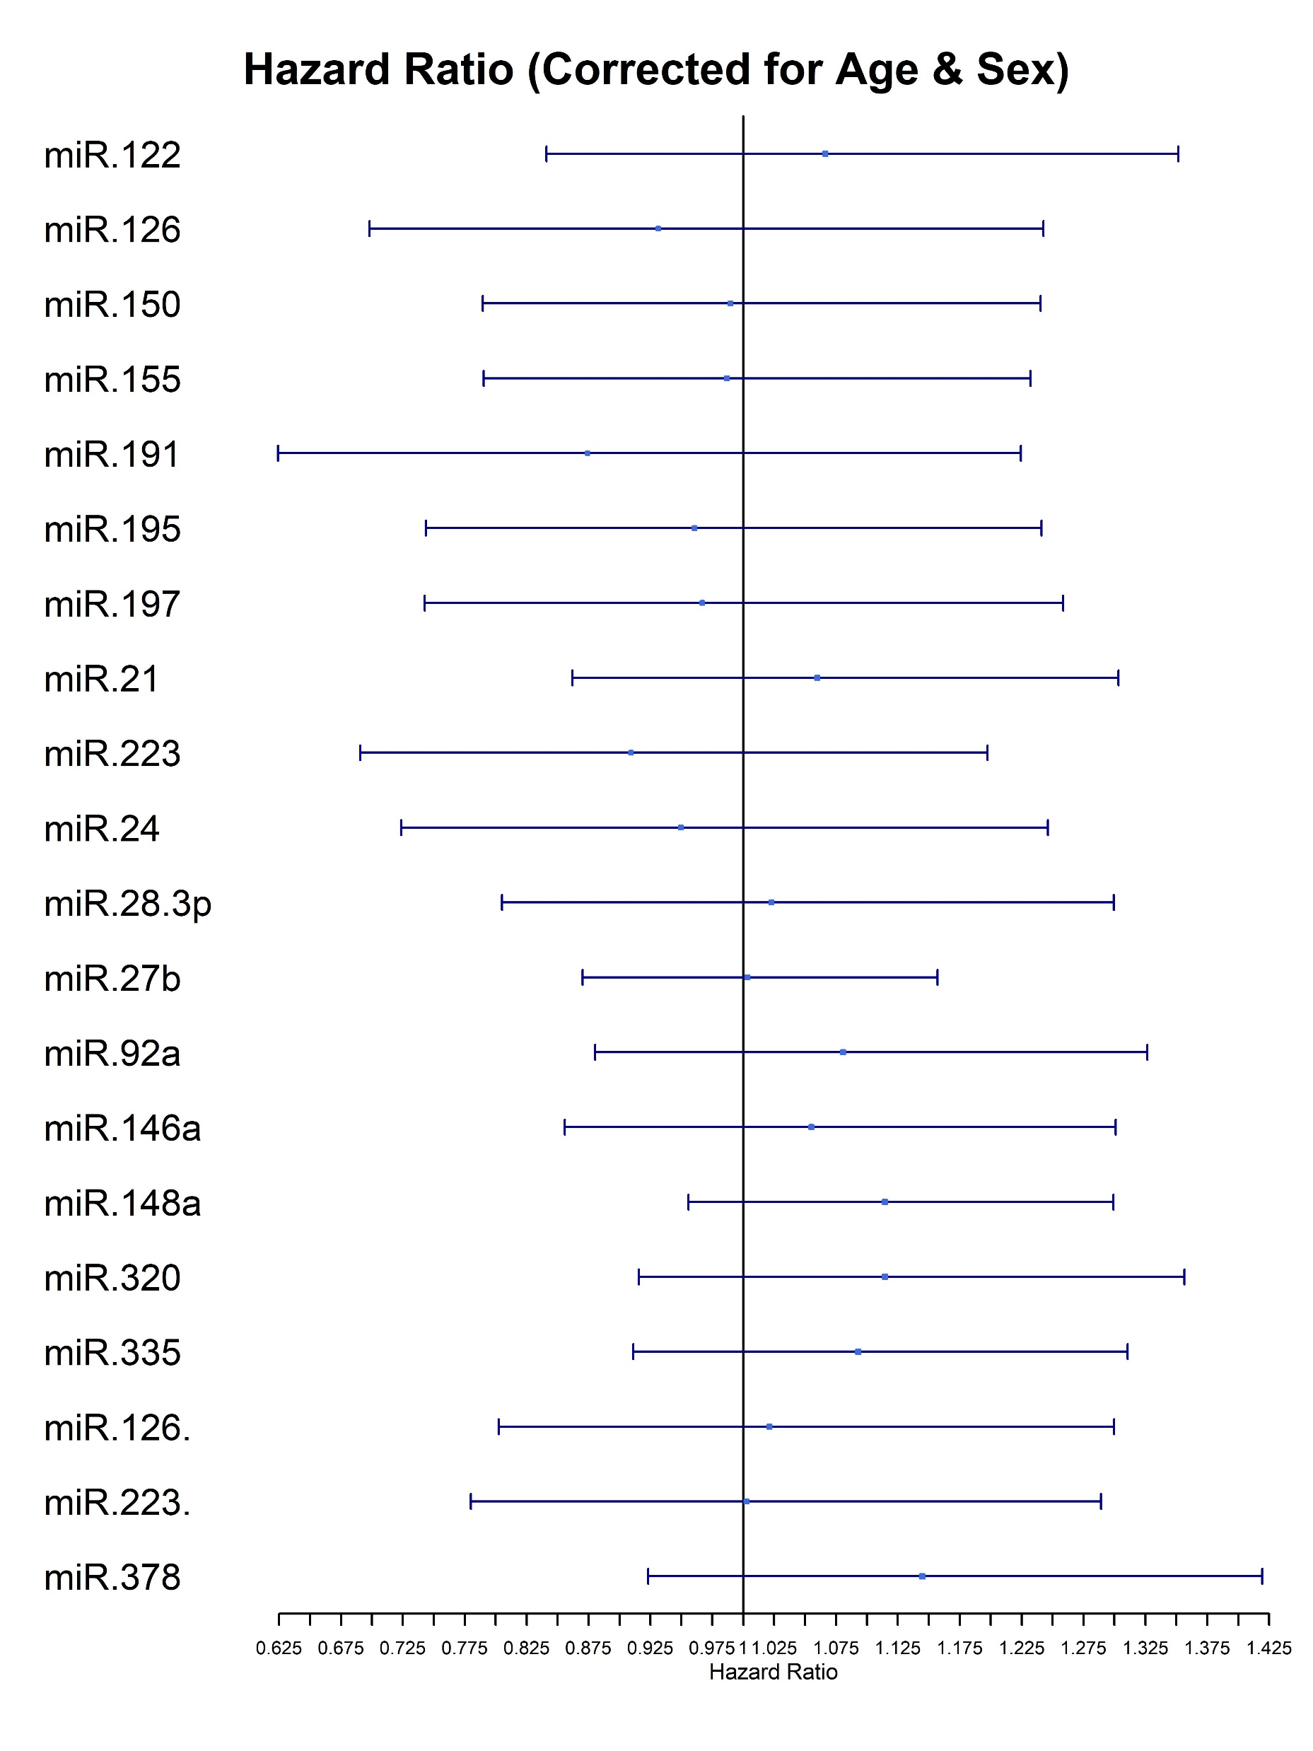
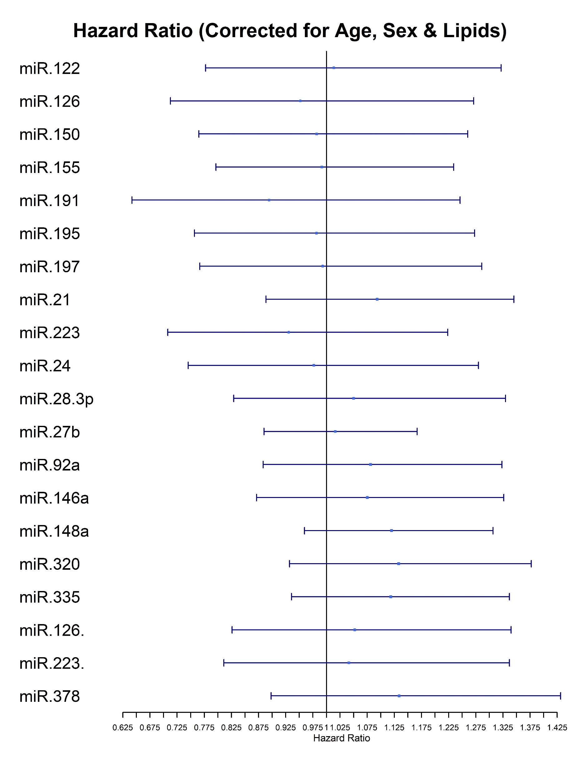
Cox Regression: Hazard Ratio

Slide 4
Hazard Ratio for proteins linked to miRNAs

Slide 5
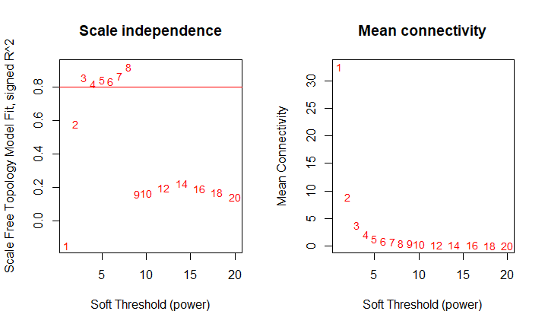
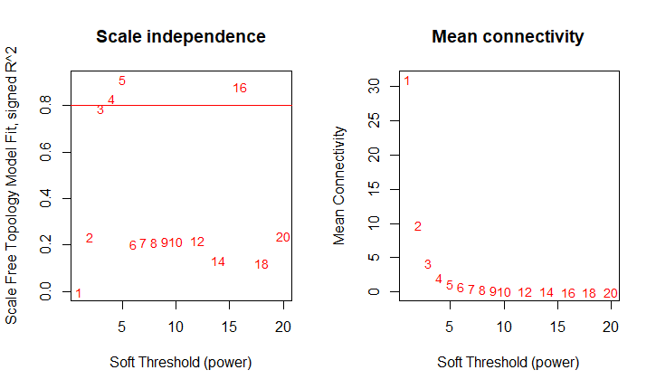
Scale-Free Topology Graph
2000
2015

Slide 6
Placeholder - pipeline

Slide 7
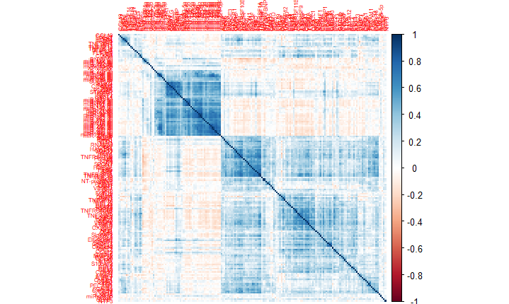
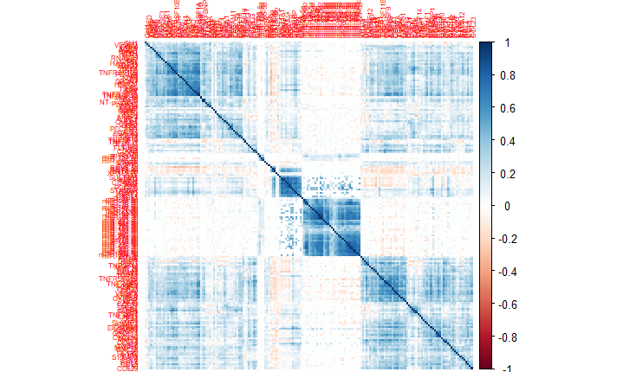
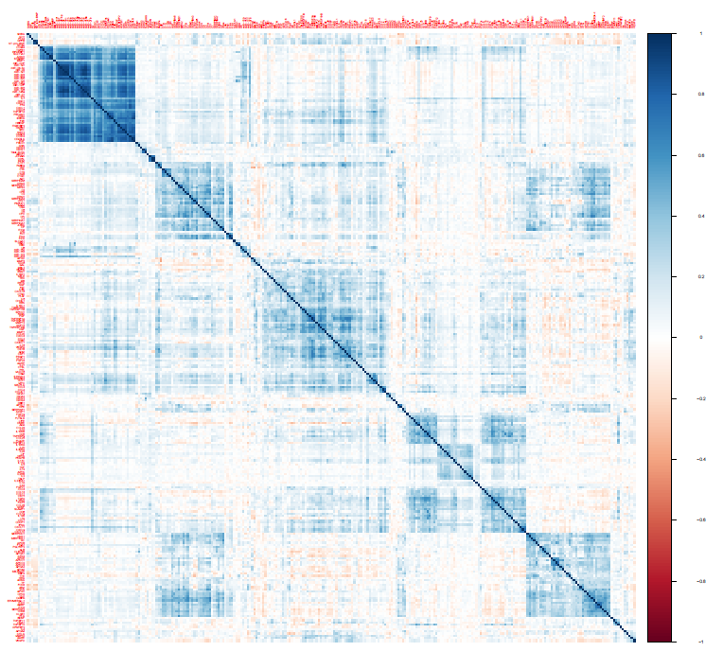
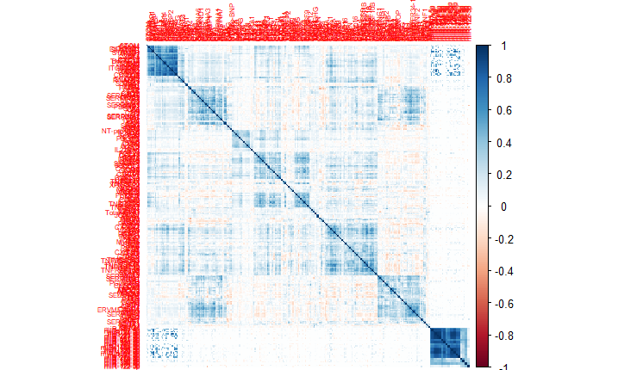
Spearman Correlation Matrix
2015 Unweighted 2015 Weighted
2000 Unweighted 2000 Weighted

Slide 8
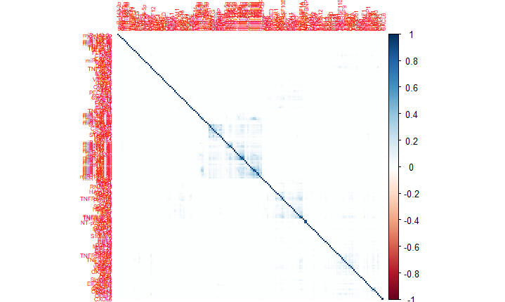
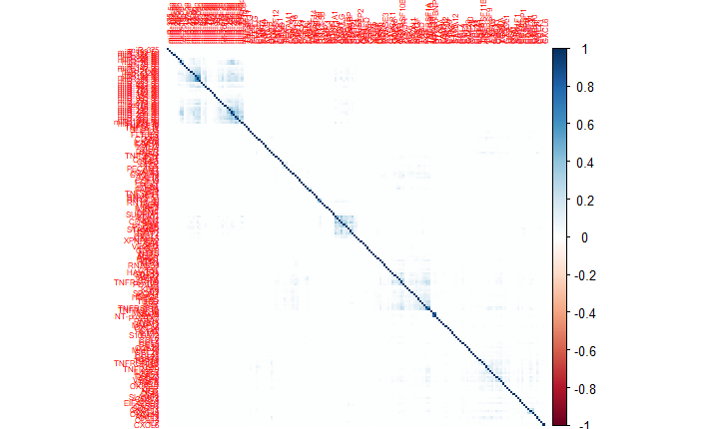
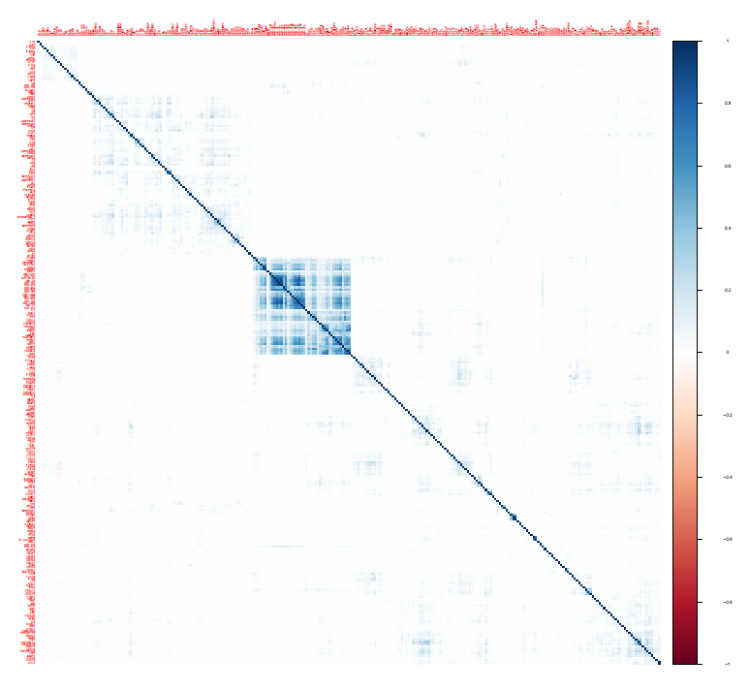
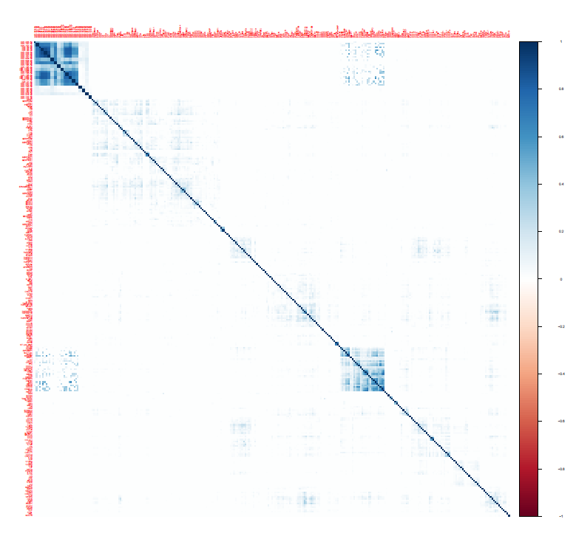
Adjacency Matrix
2015 Unweighted 2015 Weighted
2000 Unweighted 2000 Weighted

Slide 9
miRNAs – Proteins table

Slide 10
2000 – miRNA targets

Slide 11
2015 – validated

Slide 12
Strong negative corr w. miRNA - liver

Slide 13
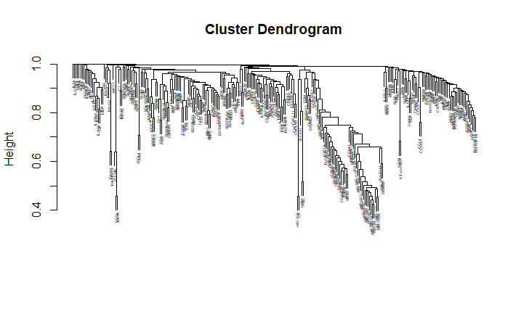
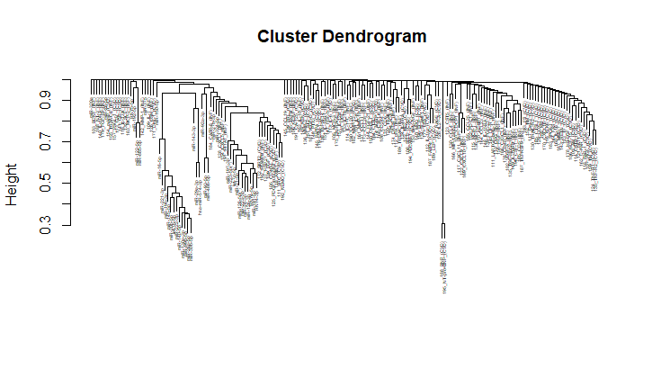
Dendrogram
2000
2015

Slide 14
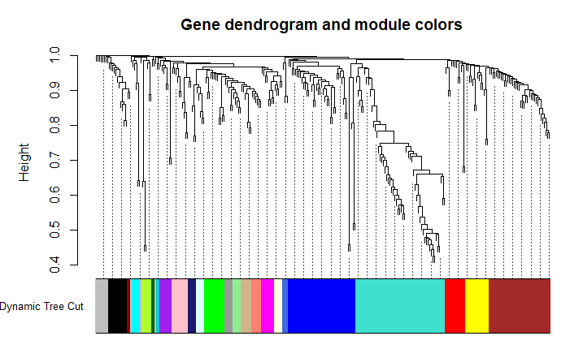
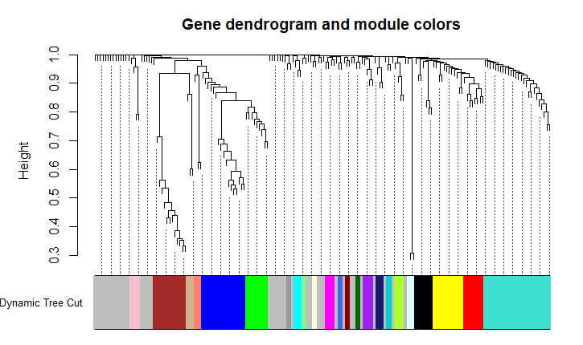
Dendrogram - Clusters
2000
2015

Slide 15
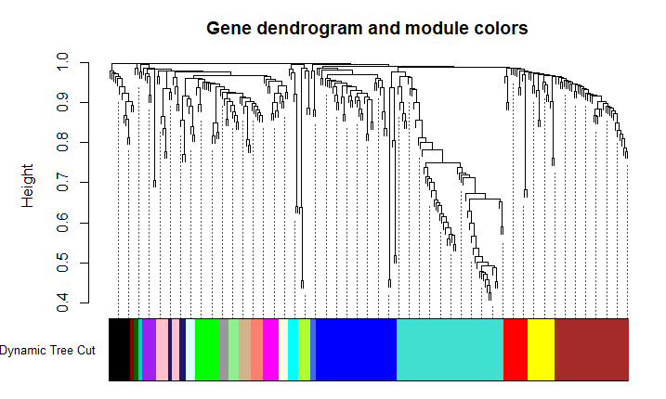
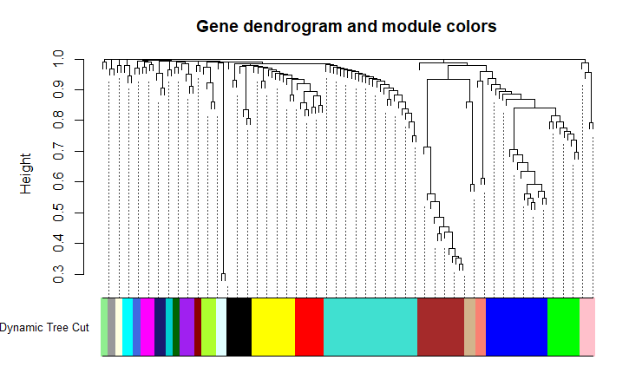
Dendrogram – Clusters, no unassigned
2000
2015
miR-122, XPNPEP2
Liver miRNAs

Slide 16
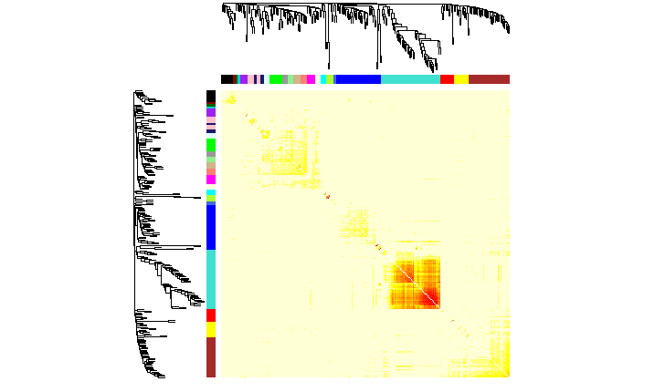
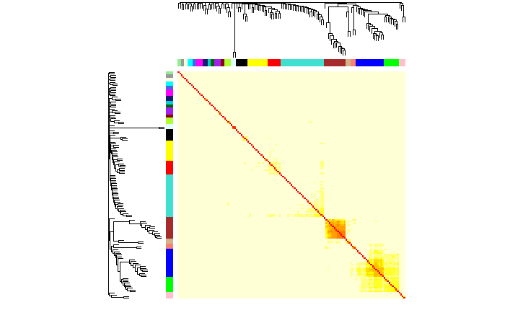
TOMplot
2000
2015

Slide 17
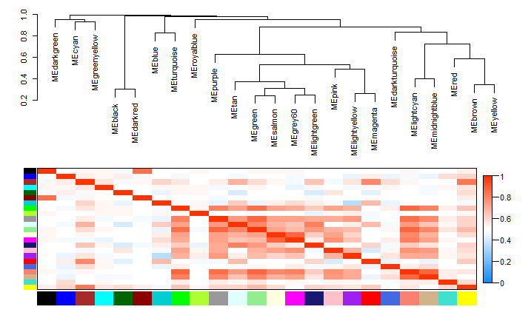
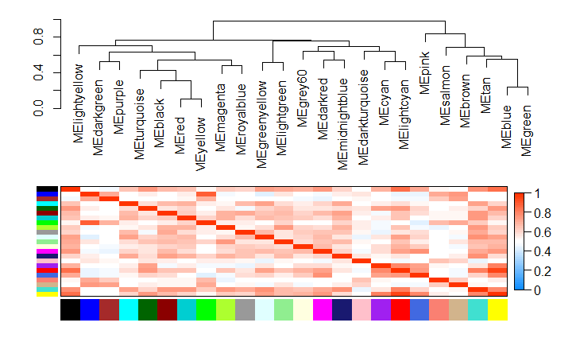
Eigengene plot
2000
2015

Slide 18
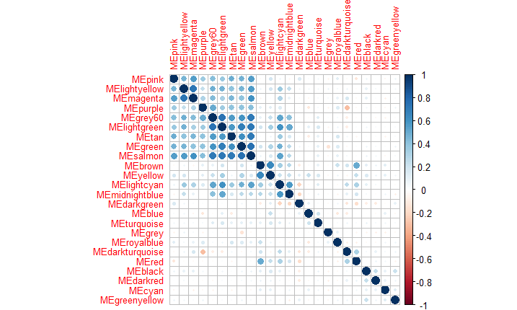
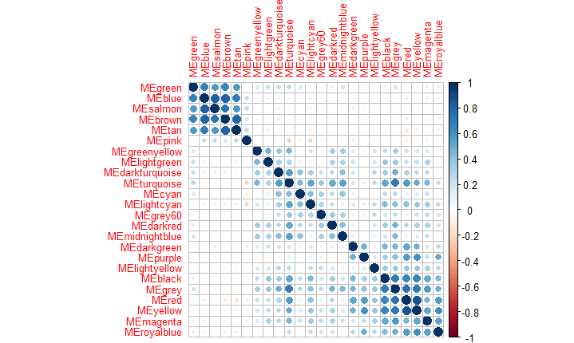
Eigengene plot - corrplot
2000
2015

Slide 19
Spectral Plot – Calinski-Harabasz Index
2000
2015

Slide 20
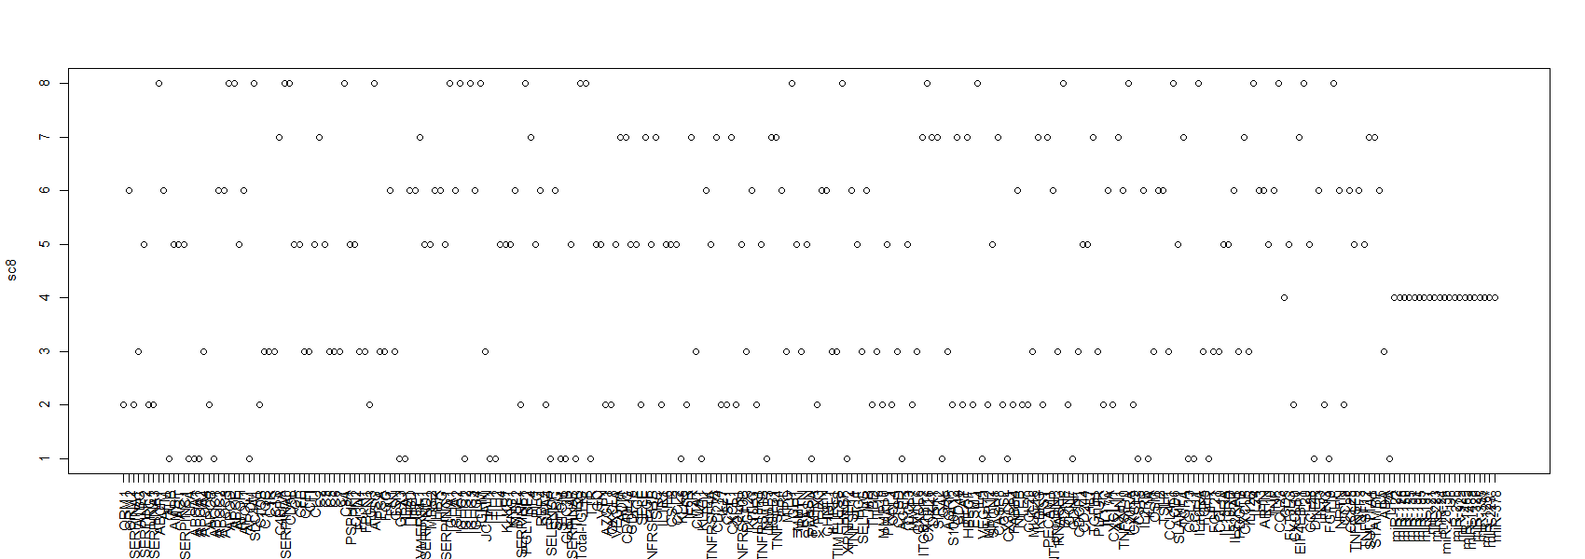
Spectral Plot 2000 – 8 Clusters

Slide 21
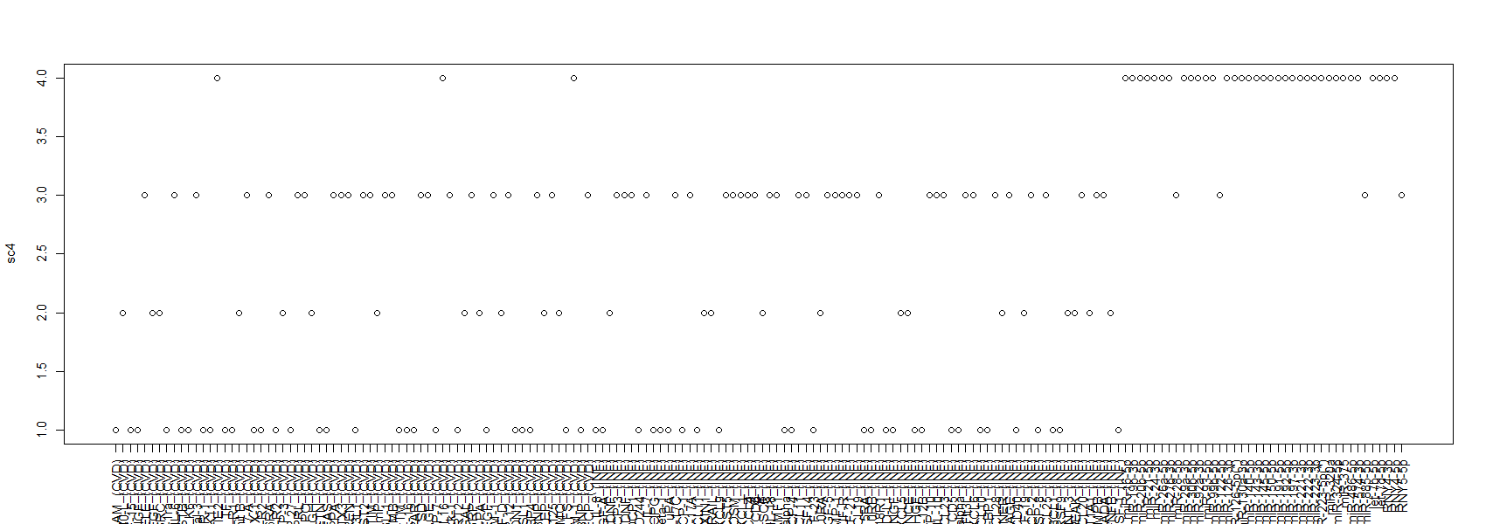
Spectral Plot 2015 – 4 Clusters
RNAs in red: miR-28-5p
miR-122-5p
miR-885-5p
RNY5-5p

Slide 22
Merged calinhara

Slide 23
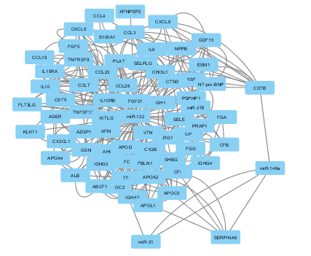
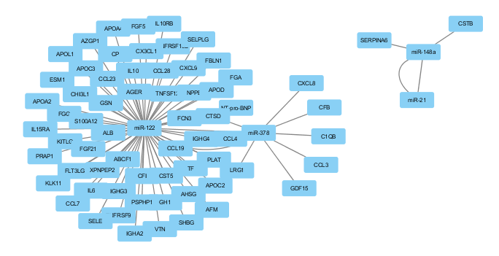
Network – Liver miRNAs + Targets (2000)

Slide 24
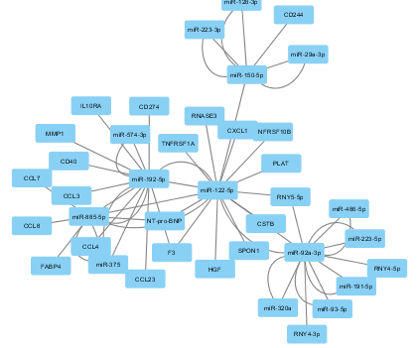
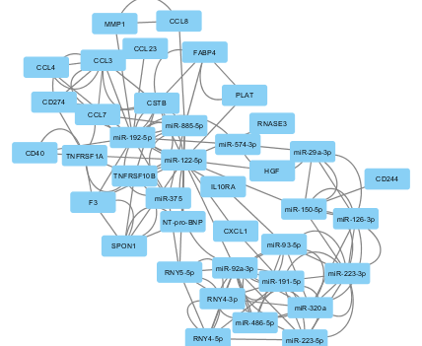
Network – Liver miRNAs + Targets (2015) - targeted edges - 2000 + 2015 validation - remove dup edges

Slide 25
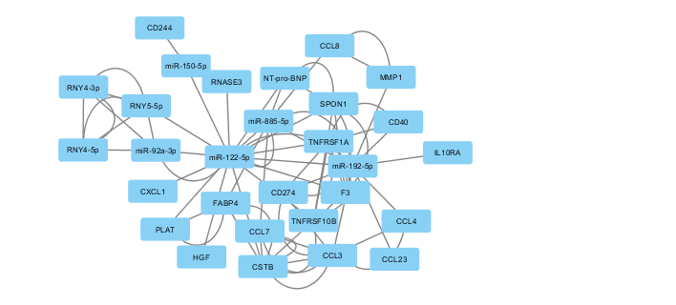
All miRNAs + highlight liver-related
All liver-related

Slide 26
miR-16-5p miR-19b-3p
miR-20b-5p miR-26a-5p
miR-30b-5p miR-99b-5p
miR-130a-3p miR-140-5p
miR-145-5p miR-150-5p
miR-221-3p miR-222-3p
let-7b-5p
CD40LG EGF
SRC PDGFB
HSPB1 SIRT2
IKBKG AXIN1
STAMBP
CXCL1 CXCL5 CASP8
SULT1A1 miR-21-5p miR-24-3p
miR-27b-3p miR-126-3p miR-126-5p
miR-191-5p miR-197-3p miR-223-3p
miR-223-5p miR-324-5p let-7d-5p
RNY4-3p RNY4-5p
miR-92a-3p
miR-93-5p
miR-486-5p
miR-122-5p
miR-192-5p
miR-885-5p
RNY5-5p
miR-29a-3p
miR-143-3p
miR-574-3p
MPO
RNASE3
TNFSF14
IL18R1
PAPPA
PTX3
ESM1
IL27
NPPB
NT-pro-BNP
IL1RN
PLAT
FABP4
LEP
CHI3L1
CTSD
CCL11
CCL28
SELE
TEK
PECAM1
MMP12
CXCL8
IL17C
CCL20
CD244
CD6
MMP3
IL1RL1
ADM GDF15 PGF
CSTB KLK6 LGALS3
F2R KLK11 F3
TNFRSF1A OLR1 TNFRSF10B
TNFRSF1B RETN FAS
HAVCR1 MB THBD
IL16 PLAUR MMP7
CXCL16 HBEGF SPON1
CTSL FST
VEGFA TGFA
IL10RB CD5
CD40 CX3CL1
TNFRSF9 CSF1
CCL7
S100A12
TNFRSF11B TGFB1
CCL2 CCL13
FGF23 LIFR
IL15RA CD274
HGF CCL23
EIF4EBP1 CCL25
PLAU
DNER
TNFSF12
ADA
CDCP1 CXCL11
CXCL9 CST5
CCL4 CCL3
CXCL10

